Slide 1
Converting fractions to terminating decimals
Comparing and ordering fractions and decimals (positive and negative)

Slide 2
how to use Oak lessons

Slide 3
I can divide the numerator of a fraction by its denominator and know that this results in an equivalent terminating decimal.

Slide 4
Prime factors are the factors of a number that are, themselves, prime.
Example
1260
= 126
× 10
= 2
× 63
×
2 × 5
×
7 ×
9 × 2 × 5
= 2
= 2
× 7
×
3 × 3
× 2 × 5
= 2 × 2 × 3 × 3 × 5 × 7

Slide 5
A terminating decimal is one that has a finite number of digits after the decimal point.
Example
Example
Non example
Non example

Slide 6

Converting fractions to terminating decimals
Recognising terminating and non-terminating
Using a calculator

Slide 7
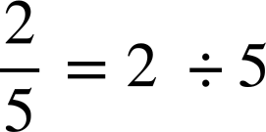
Recognising terminating and non-terminating
Short division is a straightforward approach to identify the fraction as a decimal.
This is because the line of the fraction means divide.
Example

Slide 8
Recognising terminating and non-terminating
So let’s do some short division to determine if the fraction gives a terminating decimal or not.
Example
Is
a terminating decimal?
.
0
4
5 2
.
0
0.4
2
Yes, it is a terminating decimal.

Slide 9

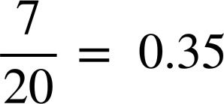
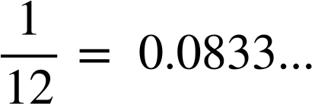

Recognising terminating and non-terminating
Using short division, show if the following fractions give a terminating decimal or not.
Using short division, show if the following fractions give a terminating decimal or not.
.
.
0
1
2
5
0
3
5
8 1
.
20 7
.
a)
1
2
4
a)
7
10
0
0
0
0
0
It is a terminating decimal.
It is a terminating decimal.
.
.
3
0
3
3
3…
0
0
8
3…
3 1
.
.
b)
b)
12 1
4
4
1
1
1
1
10
0
0
0
0
0
0
0
It is not a terminating decimal.
It is not a terminating decimal.

Slide 10





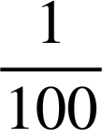
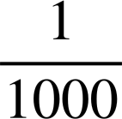
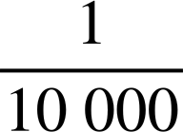
Recognising terminating and non-terminating
Short division is a good method, but sometimes the denominator can be made into a power of 10. This means we can work out the decimal equivalent easily without division. A place value chart can help.

Slide 11

Recognising terminating and non-terminating
0
3
So
as a decimal is 0.3

Slide 12

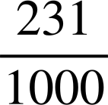
Recognising terminating and non-terminating
0
2
3
1
So
as a decimal is 0.3

Slide 13
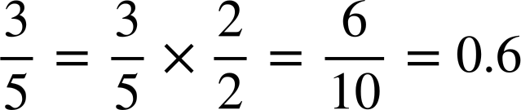
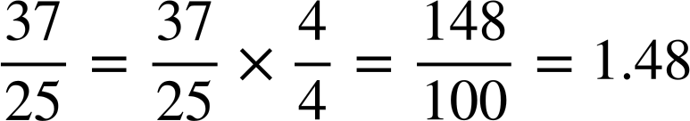
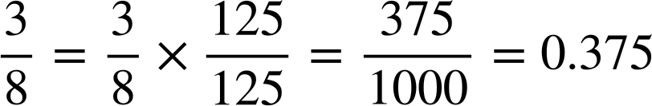
Recognising terminating and non-terminating
Sometimes the denominator is not given as a power of 10 so we need to use our knowledge on equivalent fractions to convert the denominator to a power of 10.
Example
Example
Example

Slide 14
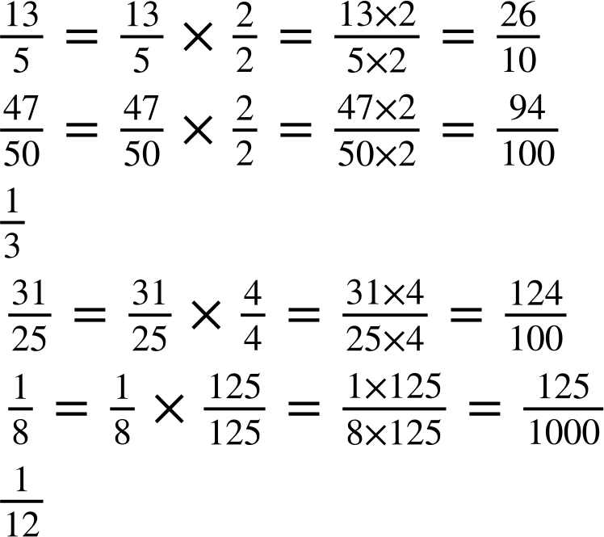
Recognising terminating and non-terminating
Work out the decimal value of the
Work out the decimal value of the
fraction
fraction
This gives the decimal value of 2.6
This gives the decimal value of 1.24

Slide 15
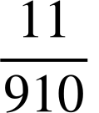
Recognising terminating and non-terminating
If we only need to determine if a fraction is equivalent to a terminating decimal or not we can use another approach.
For example
Is
a terminating decimal?
You might not want to do short division here to identify if this fraction is equivalent to a terminating decimal or not.

Slide 16
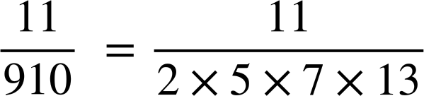
Recognising terminating and non-terminating
Simplifying the fraction and writing the numerator and denominator as a product of its prime factors will help.
The prime factors must only have bases of 2 and/or 5 as these are the only prime factors of 10.
For example
Is
a terminating decimal?
No because the denominator must only have bases of 2 and/or 5 for it to be terminating.

Slide 17
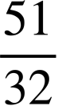
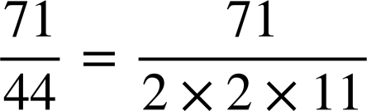
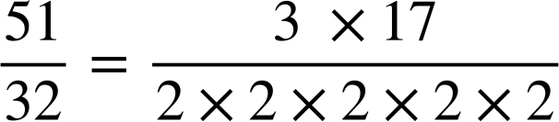
Recognising terminating and non-terminating
Identify if
is equivalent to a
Identify if
is equivalent to a
terminating decimal.
terminating decimal.
The denominator has prime factors with bases of 2 and/or 5 so it is a terminating decimal.
The denominator has prime factors with bases of 2 and 11 so it is not a terminating decimal.

Slide 18

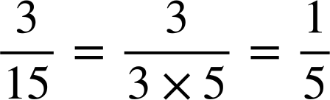
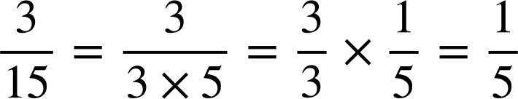
Recognising terminating and non-terminating
Laura says
is not terminating because the denominator of
15 has 3 as a prime factor.
However,
is a terminating decimal.
Explain what Laura needs to do first before deciding if the fraction is terminating.
She needs to simplify the fraction first.
This shows the fraction is so it is equivalent to a terminating decimal.

Slide 19
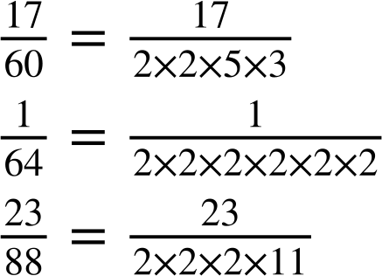

Recognising terminating and non-terminating
Identify if the following fractions are equivalent to terminating or non-terminating decimals.
a)
b)
c)

Slide 20
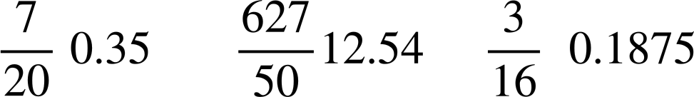

Recognising terminating and non-terminating
Without a calculator, calculate the decimal value of the following fractions:
a)
d)
b)
e)
c)
d)

Slide 21


Recognising terminating and non-terminating
is not equivalent to a terminating decimal.
Lucas says
The prime factors of the denominator are 2, 3 and 11.
2)
Explain why
is equivalent to a terminating decimal.

Slide 22
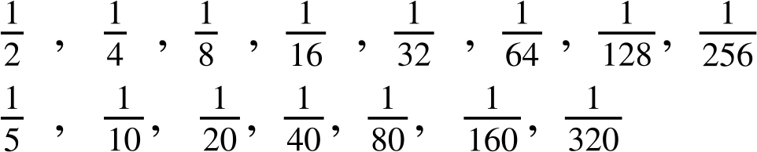
Recognising terminating and non-terminating
3) Jacob has discovered all these denominators will give a terminating decimal.
Can you explain why?

Slide 23





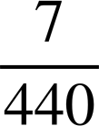




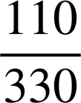
Recognising terminating and non-terminating
4) Circle all the terminating decimals.

Slide 24



Recognising terminating and non-terminating
Without a calculator, calculate the decimal value of the following fractions:
a)
d)
b)
e)
c)
f)

Slide 25
Recognising terminating and non-terminating
is not equivalent to a terminating decimal.
The prime factors of the denominator are 2, 3 and 11.
Lucas says
2)
Explain why
is equivalent to a terminating decimal.
Lucas needed to simplify the fraction

Slide 26
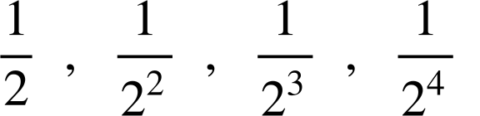
Recognising terminating and non-terminating
3) Jacob has discovered all these denominators will give a terminating decimal.
Can you explain why?
All of the denominators only have a prime factor base of 2, so all are factors of powers of 10.
....

Slide 27
Recognising terminating and non-terminating
4) Circle all the terminating decimals.

Slide 28
Converting fractions to terminating decimals
Recognising terminating and non-terminating
Using a calculator

Slide 29
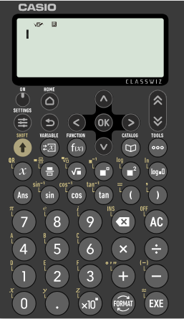

Using a calculator
Scientific calculators are fantastic tools.
The Casio fx 991 classwiz allows you to change the format of a number.
For example, let’s input
The fraction
and convert it into
decimal form

Slide 30
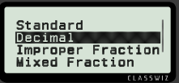
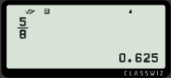
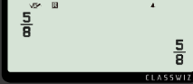


Using a calculator
The Casio fx 991 classwiz allows you to change the format of a number.
Press
To convert to a decimal

Slide 31
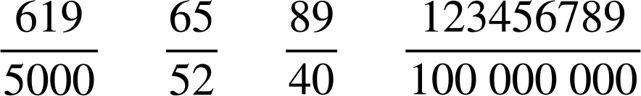
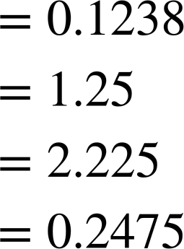
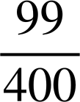
Using a calculator
Using a calculator, work out the equivalent decimals.
a)
b)
c)
d)

Slide 32
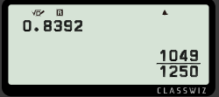

Using a calculator
The Casio fx 991 classwiz allows you change a terminating decimal into a fraction easily.
How do you think we change 0.8392 into a fraction?
Insert 0.8392 into the calculator and press

Slide 33
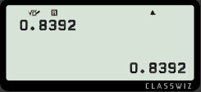
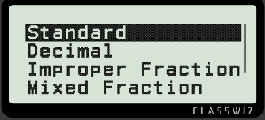

Using a calculator
The Casio fx 991 classwiz allows you change a terminating decimal into a fraction easily.
If it doesn’t convert it immediately, press
Select “Standard”

Slide 34
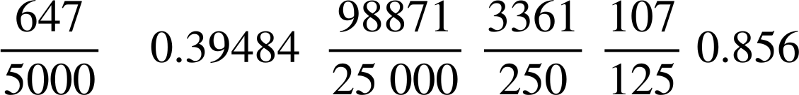
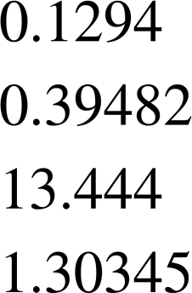

Using a calculator
Using a calculator, match the fraction to its terminating decimal.

Slide 35
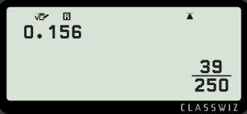
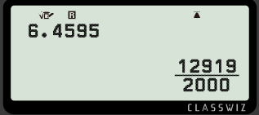
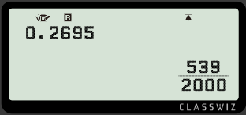
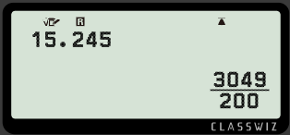
Using a calculator
2) Find the missing value(s) on the calculator displays.

Slide 36
Using a calculator
Using a calculator, match the fraction to its terminating decimal.

Slide 37
Using a calculator
2) Find the missing value(s) on the calculator displays.

Slide 38
Converting fractions to terminating decimals
A terminating decimal is one that has a finite number of digits after the decimal point.
Short division is a straightforward approach to identify the fraction as a decimal.
We can also identify if a simplified fraction gives a terminating decimal when the denominator has a product of its prime factors of bases of 2 and/or 5 only.
We can also use a scientific calculator to identify the decimal equivalent to a fraction and vice versa.

Slide 39

© Oak National Academy 2023.
Produced in partnership with Mathematics in Education and Industry.
Licensed on the Open Government Licence v3.0, except where otherwise stated. See Oak terms and conditions.

